Slide 1
Customer Order Data Analysis Report
BY ISHANT KOLI

Slide 2
Objective
To analyze sales performance by product, customer, and location to identify top performers and areas for improvement.
To identify patterns in delivery times and ratings to improve customer satisfaction and delivery efficiency.
To determine the most popular order days and times to optimize staffing and inventory management.
To segment customers based on their purchase frequency and value to develop targeted marketing strategies.

Slide 3
Questions
Which product sells the most frequently?
What is the total revenue generated over the analysis period?
Which cities/locations are the best-performing in terms of sales revenue?
What is the average order value (AOV) and how does it vary by day of the week or city?
Customer and Delivery Analysis Who are the top customers by total orders or revenue?
What is the most common delivery method used by customers?
Are there any correlations between the "Order Day" (Mon/Tue/etc.) and the "Delivery Rating"?

Slide 4
DATASET

Slide 5
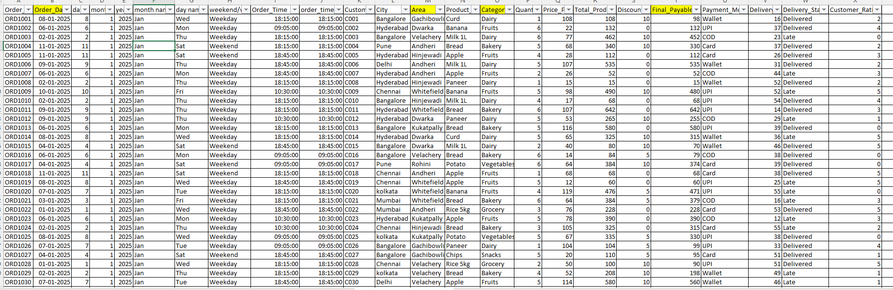

Slide 6
CHARTS

Slide 7
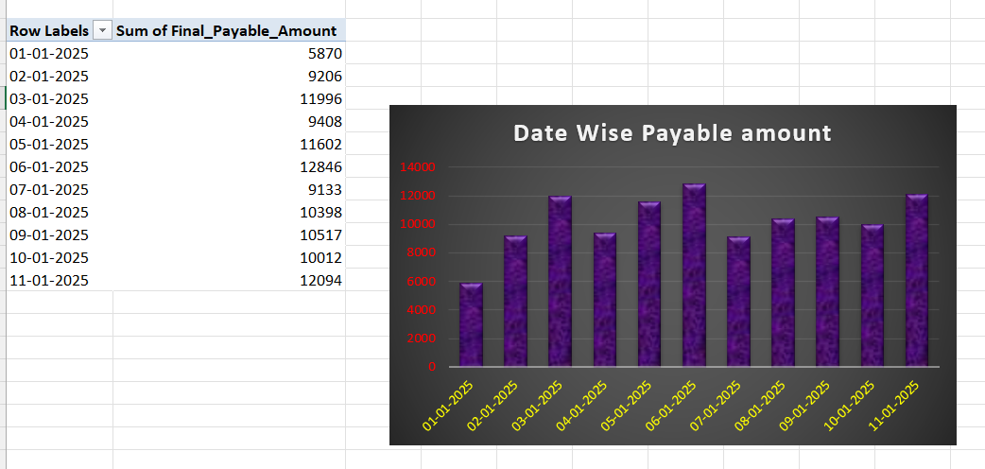
Data Wise Payable Amount

Slide 8
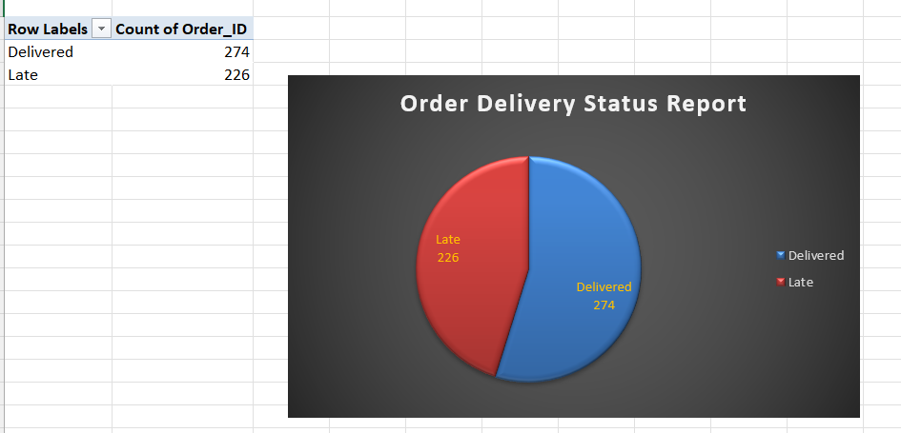
Order Delivery Status Report

Slide 9
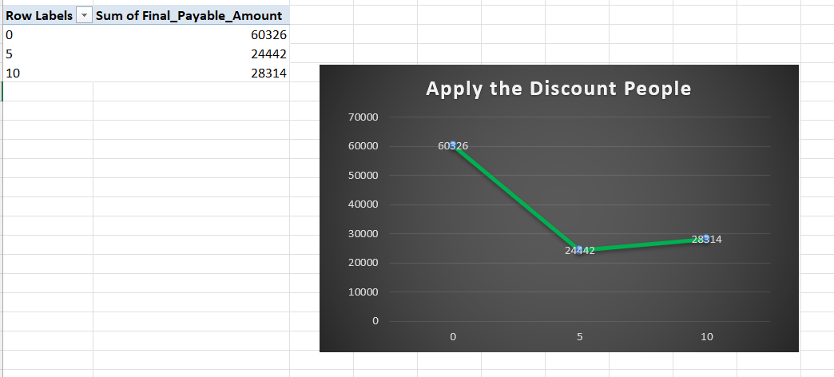
Apply The Discount People

Slide 10
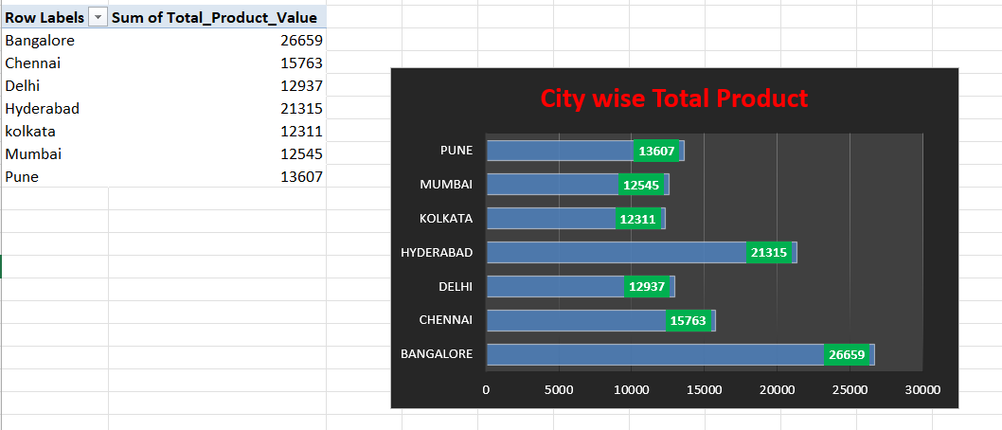
City Wise Total Product

Slide 11
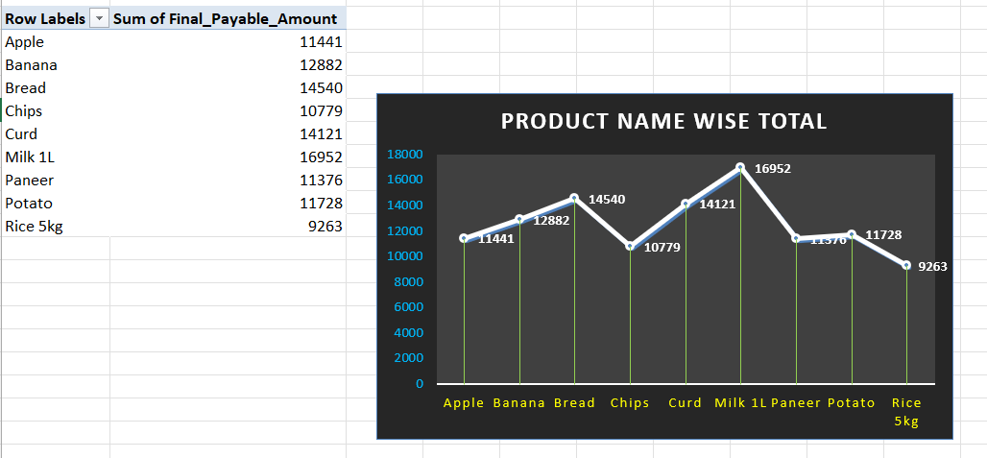
Product Name Wise Total Report

Slide 12
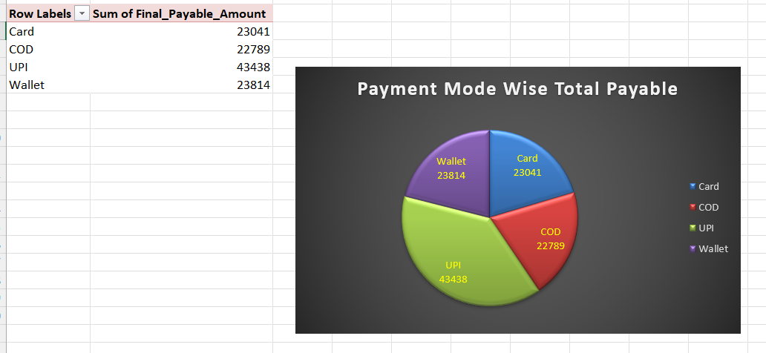
Payment Mode Wise Total Report

Slide 13
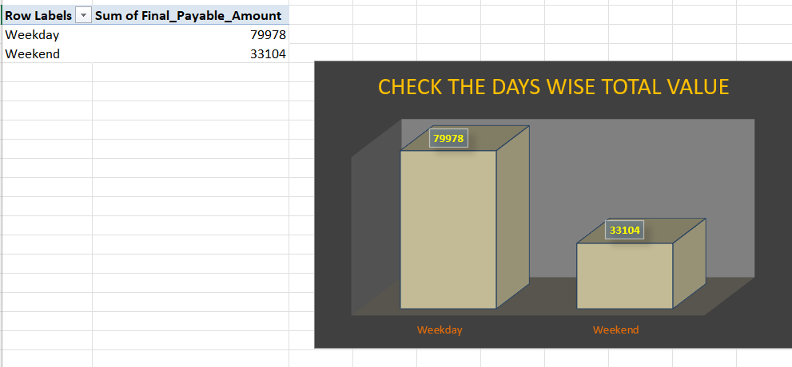
Check The Days Wise Total Value

Slide 14
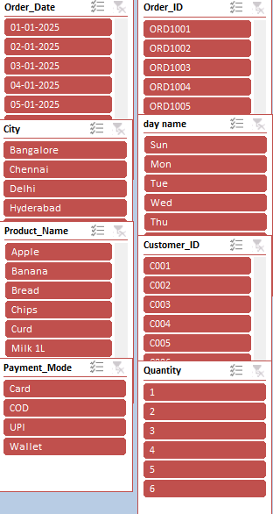
SLICERS

Slide 15
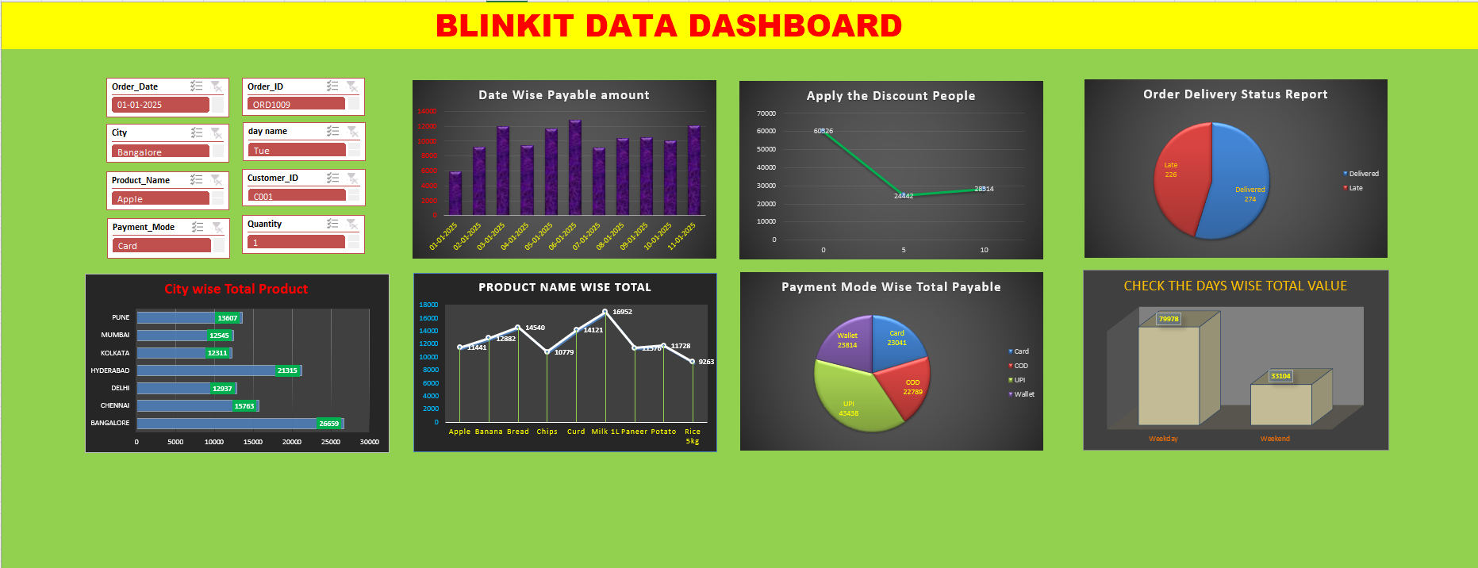
FINAL DASHBOARD

Slide 16
INSIGHTS

Slide 17
Weekends contribute a total value of 33,104, representing approximately 29.3% of the combined total of 113,082.
Only about 54.8% of orders were delivered as expected. In most industries, a "Late" rate this high would be considered a critical issue for customer satisfaction and retention.
Despite the small uptick at the end, the final value at point 10 (28,314) remains significantly lower than the starting value at point 0 (60,326), showing an overall net loss of over 53% across the charted range.
Bangalore’s volume (26,659) is more than double that of Kolkata, Mumbai, or Delhi. This suggests a heavy reliance on or a much stronger market presence in the South Indian hubs (Bangalore and Hyderabad).

Slide 18
Milk 1L is the top performer: This product has the highest total volume at 16,952 units.
Wallet Usage is Surprisingly High Often, Wallets (like Paytm, PhonePe wallet, etc.) lose ground to UPI, but in your data, Wallets are actually slightly higher than Cards.
The total value generated on weekdays is more than 2.4 times higher than that of the weekends.

Slide 19
CONCLUSION

Slide 20
Core Business: High demand for daily essentials like Dairy, Bakery, and Fruits
Major Markets: Highest activity is seen in Bangalore and Hyderabad, specifically in areas like Whitefield and Dwarka.
Biggest Pain Point: Delivery delays. There is a high frequency of "Late" statuses, which is causing many 0 and 1-star customer ratings.
Payment Trends: Customers are using a mix of UPI, Wallets, and COD, showing a preference for digital payments but a continued reliance on cash.

Slide 21
THANK YOU !!

